Slide 1
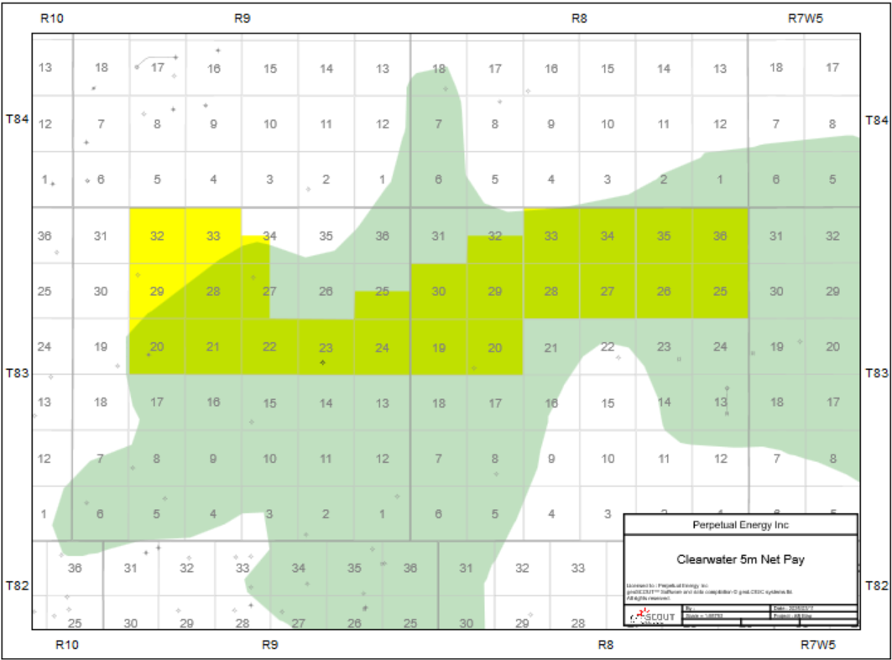
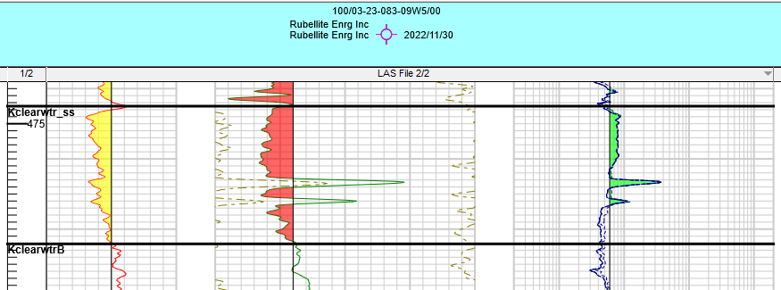
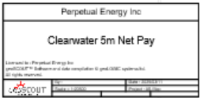
Rubellite Asset Profile | North Utikuma
Contiguous Land Position with Clearwater Potential
Land Overview:
Rubellite 100% WI
Large land position with Clearwater potential
Crown S/S royalty, no additional GORs
Prospect Overview:
10m of oil-stained sand encountered by vertical test
Core and logs indicate porosity >30% and permeability >1000mD
Low disturbance pad is constructed
Near highway access

